Slide 1
Individual fairness and group fairness
Dr. Ogerta Elezaj

Slide 2
Fairness Definitions
Individual fairness
A requirement having the goal of treating similar individuals in a similar way. Individuals that are similar with regard to the task should be given similar decisions.
Group fairness
Partitions a population into groups defined by protected attributes. Privileged groups should be treated similarly to the unprivileged groups.

Slide 3























Individual vs Group
c1 0.82
c2 0.80
c3 0.81
c1
c1
c2
c4
c3
c2
c4 c5
0.77 0.79
c4 0.78
ranking
c4
c5
c5
c3
c6
c6
fair for individuals
unfair for female group
fair for female group
unfair for individuals c2, c3

Slide 4




















Group Fairness vs. Individual Fairness
Group fairness requires that the protected groups should be treated similarly to the advantaged group.
Group = Male Advantaged
We need to be fair for both male and female applicants
Group = Female Protected
Require the same acceptance rate for both male and female job applicants

Slide 5
Individual fairness
Different individuals should be treated similarly.
--It imposes restriction on the treatment for each pair of individuals

Slide 6
Individual fairness
Treat similar individuals similarly.
Binary Classification Algorithm
--Positive or negative/1 or 0/accept or reject
Any two individuals who are similar with respect to a particular task should be classified similarly
Similar for the purpose of the classification task
Similar distribution over outcomes

Slide 7
Similarity
How do we define similarity?
--It is hard to determine an appropriate metric to measure the similarity of two individuals.
We assume a distance metric
--Similarity metric between individuals d(x,y)
---# of features
---Graphical distance (like word embedding)
Similarity measurements between distributions of outcome D(x,y)

Slide 8
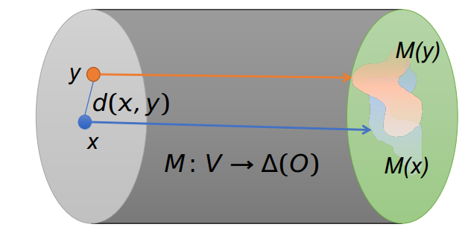
Representations (Informal)
𝑋: All possible real people
Algorithm operates only on a representation of the person
The algorithm only knows what it is told about you
Distinct individuals may be mapped to the same representation
How can we compare M(x) with M(y)?

Slide 9
Statistical Distance
Numerical measure of how different two data objects are
A function that maps pairs of objects to real values
Lower when objects are more alike
Higher when two objects are different
Minimum distance is 0, when comparing an object with itself.
Upper limit varies
A distance function d is a distance metric if it is a function from pairs of objects to real numbers such that:
d(x,y) > 0. (non-negativity)
d(x,y) = 0 iff x = y. (identity)
d(x,y) = d(y,x). (symmetry)
d(x,y) < d(x,z) + d(z,y) (triangle inequality).

Slide 10
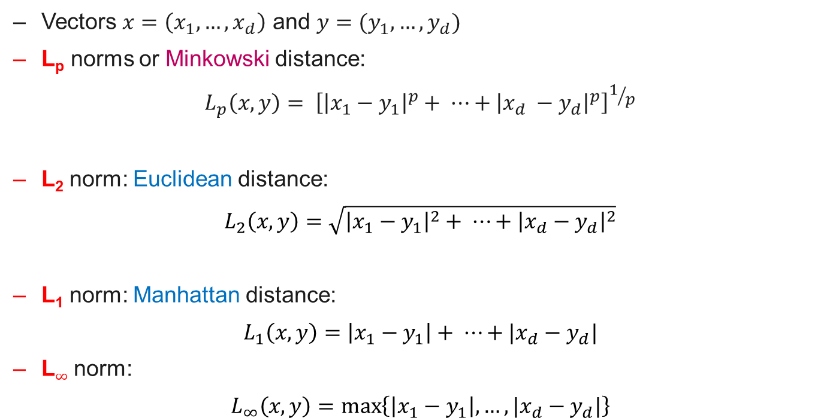
Example: statistical distance
Vectors $x=\left(x_{1},…,x_{d}\right)$ and $y=(y_{1},…,y_{d})$
L_{p} norms or Minkowski distance:
$$L_{p}\left(x,y\right)= {\left[{\left|x_{1}−y_{1}\right|}^{p}+ ⋯+{\left|x_{d} −y_{d}\right|}^{p}\right]}^{1/p}$$
L₂ norm: Euclidean distance:
$$L_{2}\left(x,y\right)=\sqrt{{\left|x_{1}−y_{1}\right|}^{2}+ ⋯+{\left|x_{d}−y_{d}\right|}^{2}}$$
L₁ norm: Manhattan distance:
$$L_{1}\left(x,y\right)=\left|x_{1}−y_{1}\right|+ ⋯+|x_{d}−y_{d}|$$
L$∞$ norm:
$$L_{∞}\left(x,y\right)=\max\left\{\left|x_{1}−y_{1}\right|,…,|x_{d}−y_{d}|\right\}$$

Slide 11
Lipschitz Condition
“Any two individuals x, y that are at distance d(x, y) ∈ [0, 1] map to distributions M(x) and M(y), respectively, such that the statistical distance between M(x) and M(y) is at most d(x, y)”
Difference in outputs<= Difference in inputs
D(M(x)-M(y))<=d(x,y)

Slide 12
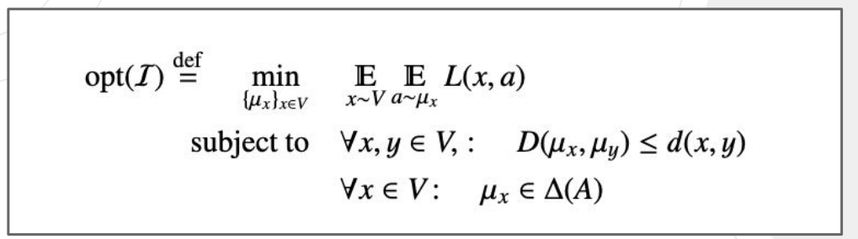
Loss Function
The loss function measures the difference between the algorithm, output and the ground truth outcome.
Minimizing loss function better and fairer!
The goal: Find a mapping from individuals to distributions over outcomes that minimizes expected loss function subject to the Lipschitz condition.

Slide 13
Group Fairness
Statistical Parity - Require admissions match demographics in data
Equal Opportunity - Require false-negative rate to be equal across groups
Predictive Equality - Require false-positive rate to be equal across groups

Slide 14
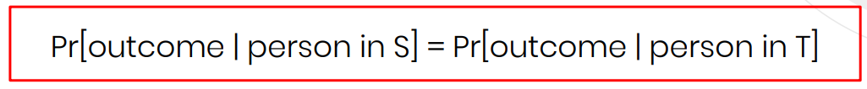
Statistical Parity
The most well-known criteria for fairness
Definition: % of individual classified positive/negative matches the % demographic of general population
Example. Hire the same % of individuals in both groups
Mathematically: Decision d is statistically independent of sensitive attribute a
Pr(d=1 | a) = Pr(d=1)
Pr(d=1 | y=0, a) = Pr(d=1 | y=0)
Pr(d=1 | y=1, a) = Pr(d=1 | y=1)

Slide 15
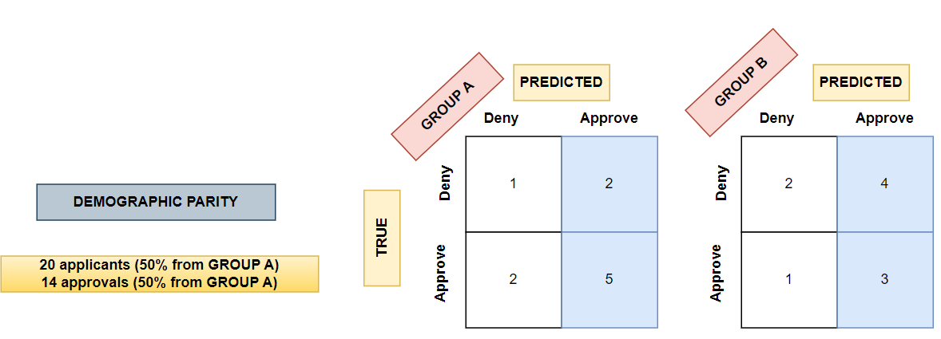
Statistical Parity-perspective of confusion matrix
Example: A loan is correctly judged when the approval or rejection decision is correct

Slide 16
Statistical Parity
Suitable when:
We want to change the state of the current world to improve it by supporting unprivileged groups (e.g. universities are aiming to improve diversity by admitting a fixed number of students from disadvantages backgrounds)

Slide 17

Equal Opportunity
Definition: Equal Opportunity states that each group should get the positive outcome at nearly equal rates, assuming that people in this group qualify for it.
Hiring example:
C=the decision made (hire or reject)
Y=the true standard of whether a person was qualified enough or not to be hired
Ex. One can be rejected (C=0) but be capable enough for the job (Y=1)
Hire equal % of individuals from the qualified subset of each group

Slide 18
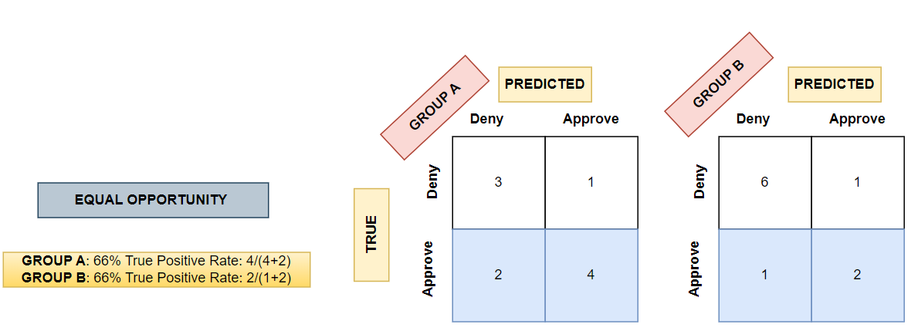
Equal Opportunity-perspective of confusion matrix
TPR should be similar across protected groups that are defined by a sensitive attribute (e.g. race, gender)

Slide 19
Equal Opportunity
Suitable :
To predict the positive outcome correctly (e.g. detecting a fraudulent transaction)
Introducing false positives are not costly (e.g. wrongly notifying a customer about fraudulent activity will not be necessarily expensive to the customer nor the bank sending the alert)
The target variable is not subjective (e.g.: labelling who is a ‘good’ employee is very subjective)

Slide 20

Predictive parity
Both groups will have the same precision. i.e. for all the positives they predicted, they have the same proportions that the predictions are correct (true positive).
Hiring example:
C=the decision made (hire or reject)
Y=the true standard of whether a person was qualified enough or not to be hired
Ex. One can be rejected (C=0) but be capable enough for the job (Y=1)

Slide 21
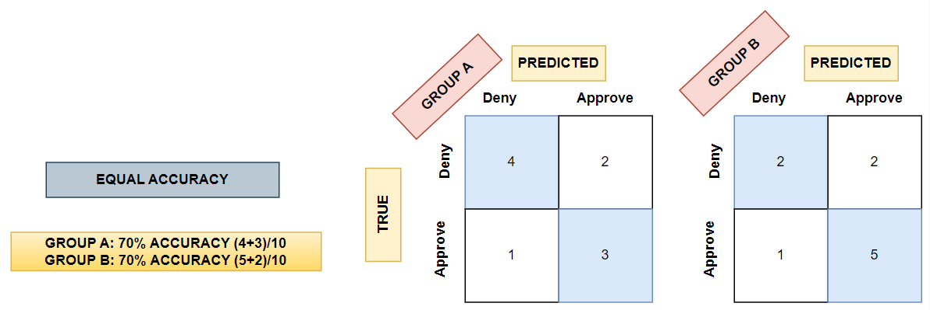
Predictive parity-perspective of confusion matrix
Accuracy parity requires equal accuracy across groups

Slide 22
Group Fairness
In practice, it is not possible to optimize a model for more than one type of fairness.
-Further reading: https://arxiv.org/abs/2007.06024
So which fairness criterion should you select, if you can only satisfy one?
-As with most ethical questions, the correct answer is usually not straightforward, as real-world models typically cannot be expected to satisfy any fairness definition perfectly.

Slide 23
Group Fairness vs. Individual Fairness
Group fairness does not guarantee individual fairness, or vice versa
Individual fairness, under certain circumstances, can promote group fairness
Since group fairness requires to satisfy conditions only on average among groups, it leaves room to bias discrimination inside the groups.

Slide 24
Conclusions
So which fairness criterion should you select, if you can only satisfy one?
As with most ethical questions, the correct answer is usually not straightforward, as real-world models typically cannot be expected to satisfy any fairness definition perfectly.
The suitable notion of fairness must be chosen in the context of the specific use case and data at hand.
While in financial services group fairness can be adopted, it would not be appropriate in medical applications where gender and race can play an important role in understanding a patient’s symptoms.

Slide 25
Reading
Castelnovo, A., Crupi, R., Greco, G. et al. A clarification of the nuances in the fairness metrics landscape. Sci Rep 12, 4209 (2022).
Barocas, S., Hardt, M. & Narayanan, A. Fairness and Machine Learning (fairmlbook.org, 2019). http://www.fairmlbook.org.
Mehrabi, N., Morstatter, F., Saxena, N., Lerman, K. & Galstyan, A. A survey on bias and fairness in machine learning. ACM Comput. Surv. (CSUR) 54, 1–35 (2021).

